Slide 1





Care of HIV in the setting of complex humanitarian emergencies in the Americas:
US and Puerto Rico
Wednesday 24 July, 14:30 – 16:00
Carmen D. Zorrilla, MD
Professor Obstetrics and Gynecology
UPR School of Medicine
Principal Investigator: CEMI, MI-HMHR, IUPR-CTU, SJ ZIP
Maternal-Infant Studies Center (CEMI)
carmen.zorrilla@upr.edu

Slide 2
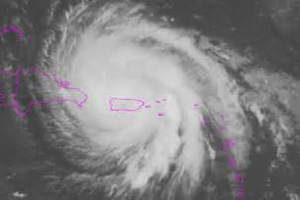
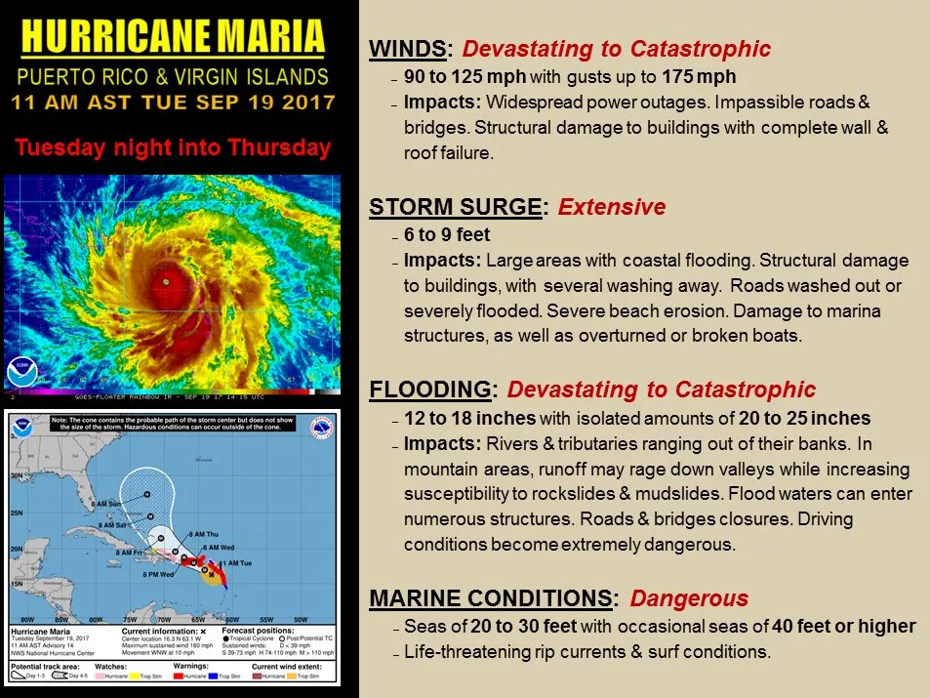

On September 20, 2017 Hurricane Maria hit Puerto Rico as a Category 4
During its life cycle an average hurricane can expend as much energy as 10,000 nuclear bombs (NASA).*
This is equivalent to 200 times the world-wide electrical generating capacity (NOAA).**
*https://science.howstuffworks.com/environmental/energy/energy-hurricane-volcano-earthquake1.htm
**http://www.aoml.noaa.gov/hrd/tcfaq/D7.html

Slide 3
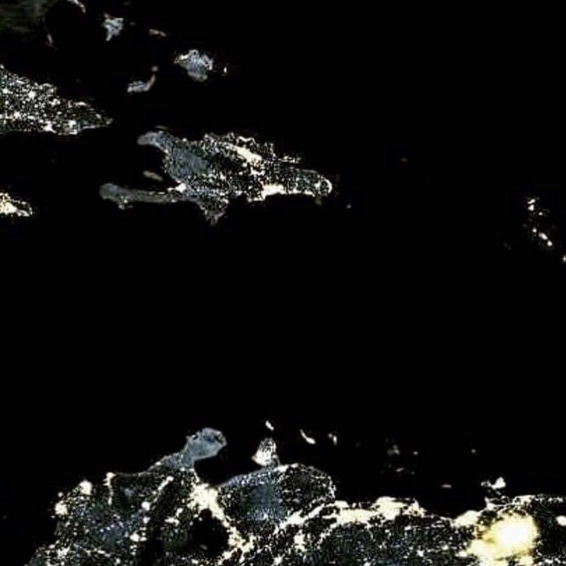
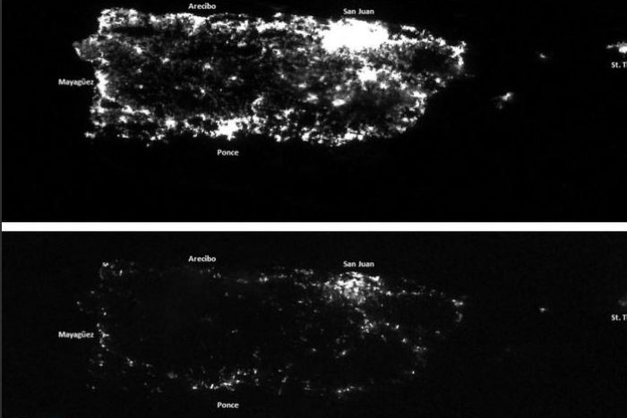
Power Grid collapse after Hurricane Maria:
Puerto Rico
Before Hurricane Maria
After Hurricane Maria
http://www.abc.net.au/news/image/8987766-3x2-700x467.jpg

Slide 4
Puerto Rico before Hurricane Maria
PR had the most severe and prolonged economic recession since the great depression in the 1930’s.
Between 2006-2016 Puerto Rico’s economy shrunk by nearly 16% and its public debt reached more than 73 billion in 2017, due to faulty bonds and 49 million due to pension obligations.
In June 2016 the US Congress approved the Puerto Rico Oversight, Management and Economic Act (PROMESA) which effectively placed the island government under direct federal control.
  46.5% poverty level
  $19,350 median household income
  10.1% unemployment rate
  35% employer sponsored health insurance
  49% Medicaid, CHIP coverage
  65% of patients medically indigent
  6% uninsured
  15% living with disability
  1% Flood Insurance
  Building codes unable to withstand 125 mph winds
  Lack of ownership deeds
Courtesy Dr. Antonia Novello
14TH Surgeon General of the United States of America

Slide 5
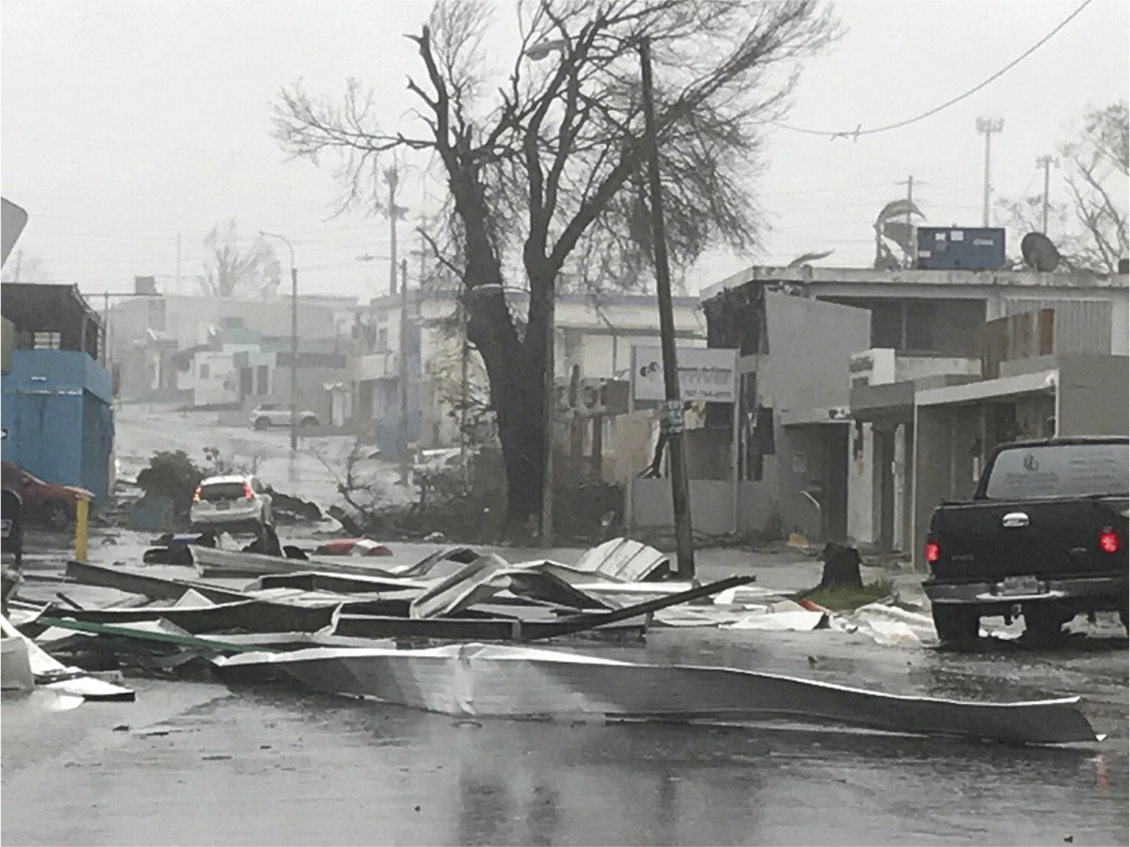


Zorrilla CD. N Engl J Med 2017. DOI: 10.1056/NEJMp1713196
Streets in Puerto Rico Blocked by Debris from Hurricane Maria.
“ My residents were overwhelmed, not just from physical exhaustion but from our patients’ stories and the difficult decisions we had to make.
We are not trained in disaster management, so we had to draw on our own personal and emotional strengths in managing the situation, aiming to provide high-quality and efficient care while maintaining our professionalism, humanism, and empathy. ”
Notes:
Figure 1. Streets in Puerto Rico Blocked by Debris from Hurricane Maria. Lourdes De Jesus.

Slide 6
Impact of Hurricane Maria on the Health Care System in PR
Increased mortality reports initially denied, later confirmed.
Concerns with outbreaks at shelters (scabies, lice, conjunctivitis).
Outbreaks/epidemics never confirmed by the state epidemiologist (i.e. Leptospirosis-74 cases).
Complete disruption of the epidemiologic surveillance systems for vector-borne diseases.
Complete disruption of Hospital care for more than a month with partial services afterwards.
Complete disruption of Primary Care and Prevention services.
Interruption of all elective surgery, procedures and care, including cancer surgery, chemotherapy for months.
Interruption and disruption of Dialysis treatments.
Interruption of Pharmacy services due to lack of power and internet.

Slide 7
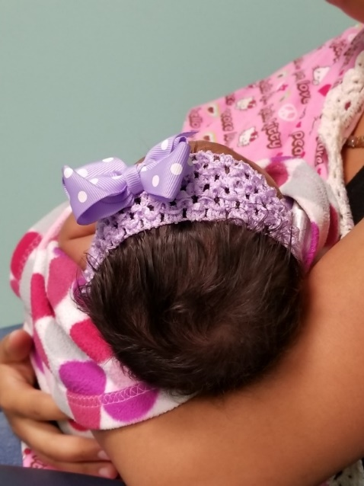
“Continuous HIV High-risk Obstetrical Services During a Hurricane”
Baby Z was born at home on September 25, 2017.
Her mother is living with HIV and had a prior C/S on November 8, 2015.
The ambulance never arrived, after the birth, they went to a local health center where the umbilical cord was cut and then she was taken to our hospital.
This photo was taken on October 24 during her post-partum visit.
She was on HAART and had undetectable VL, but wanted a repeat C/S for this pregnancy.
Fortunately, the baby is HIV negative.

Slide 8
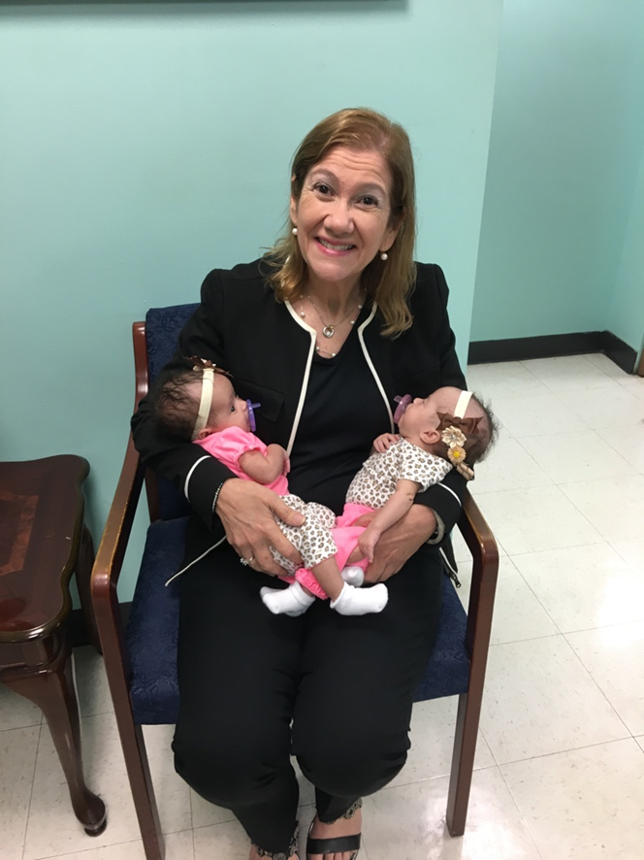
“How families were separated and concerns for treatment”
Twin girls born at the University Hospital on September 18, 2017.
Their parents are from a town 2 hrs. away from San Juan.
This photo was taken on November 3, 2017.
One baby was discharged home and the other stayed at the NICU.
They were told to come every day to the hospital.
On day 126th, they had no power, no running water and had damage to their home.

Slide 9
Percent of PLWH in Puerto Rico covered by RWHAP Part B ADAP, Government Programs, Private Plans & Other
Clients Served by the RWHAP Part B ADAP
in 2017
18,200 PLWH in Puerto Rico.
The RWHAP Part B/ADAP served a total of 10,293 clients (57%) of the PLWH.
Remaining 43% covered by available government programs, private plans, or other.
N= 10,293

Slide 10
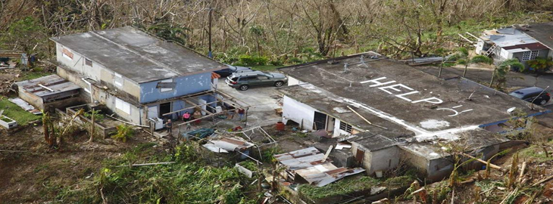
Ryan White Part B/ADAP Providers Network
The Puerto Rico Ryan White Part B/ADAP Providers (55 centers):
ADAP External Providers Network:
39 HIV clinical centers
Community-based Coordinating Agencies (CBOs):
8 agencies
Puerto Rico Department of Health (PRDOH) Communicable Diseases Prevention and Treatment Centers (CPTET, acronym in Spanish):
8 regional HIV/STI/Hep/TB Clinics

Slide 11
Preparedness
The RWHAP Part B ADAP activated its Emergency Preparedness and Contingency Plans:
Pharmacy Benefits Manager (PBM) MC-21 Corporation
  Expedite the approval of new prescriptions to eligible patients and for clients who had lost eligibility due to the storm(s);
  Remove the “refill too soon” restrictions, allowing all ADAP network pharmacies to refill medications for 30 days to all eligible clients;
  Approve the replacement of drugs to clients who had lost their medications due to the storm(s).
Medication Distribution Center
  Increase the ADAP Drugs stockpile inventory.
  Ensure power back-up at the MDC.
  Ensure alternate facility for ADAP medications.

Slide 12
Measures of Success and best practices
In spite of the devastating storms, our clients’ outcomes at the end of 2017 remained consistently high in the following three indicators: medical care retention, antiretroviral treatment, and viral load suppression.
As of August 2017
Viral Load Suppression: 82.3% ADAP Providers network
As of December 2017
Viral Load Suppression: 83.8% ADAP Providers network
Patients know each other and connected or visited.
Patients shared medications and supplies.
Providers established clinics in parking lots.
Case managers visited people who could not reach clinics
Free Access to medications though ADAP flexibilization of rules.

Slide 14
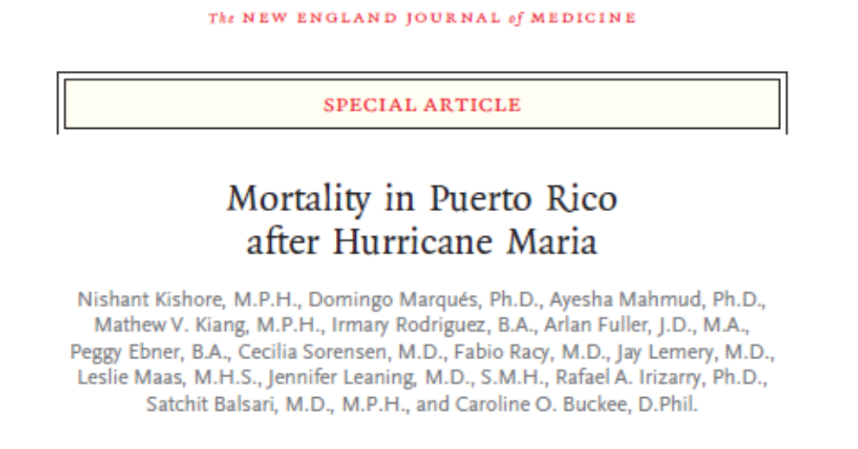
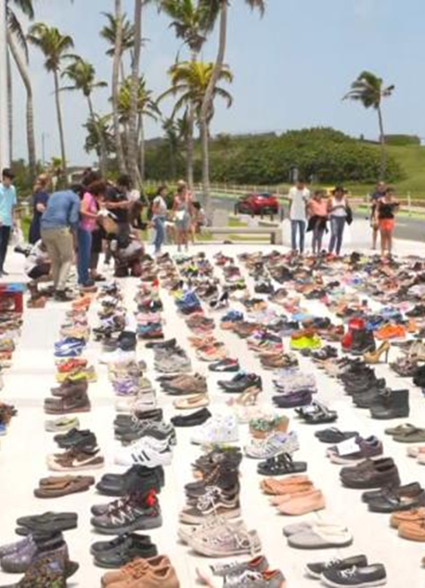
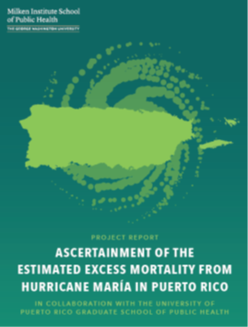
Excess mortality estimates
NY Times: 1,052
Santos-Lozada and Howard: 1,218
Official death count: 64
Kishore, Marques et al (NEJM) survey: 4,645
Milken Institute of Public Health report : 2,975
Notes:
Figure 4. Estimates of Excess Deaths and Reported Causes of Death. Panel A shows a comparison of estimates of excess deaths from official reports, press (New York Times)⁸ and academic (Santos–Lozada and Howard)⁹ reports, and from our survey. Panel B shows deaths according to the month of death and the age at death as reported in our survey, categorized according to the cause of death reported by the household member. Two persons who died of similar causes at the same age are represented by dots that are superimposed in December; thus, the 37 points shown represent 38 deaths after the hurricane.

Slide 15
Comparison of Mortality Rates
(All Causes vs. HIV/AIDS) by Year, Puerto Rico, 2015-18
ALL CAUSES
HIV/AIDS
Source: Puerto Rico Department of Health, Demographic Registrar and Vital Statistics Office

Slide 16
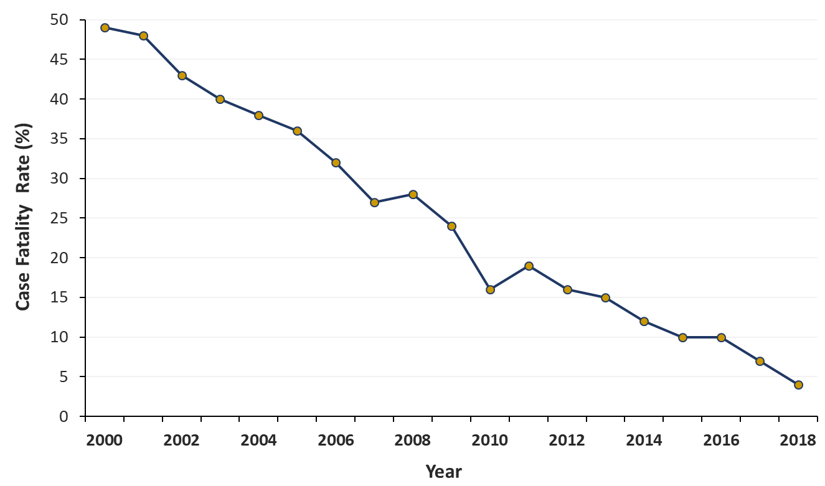
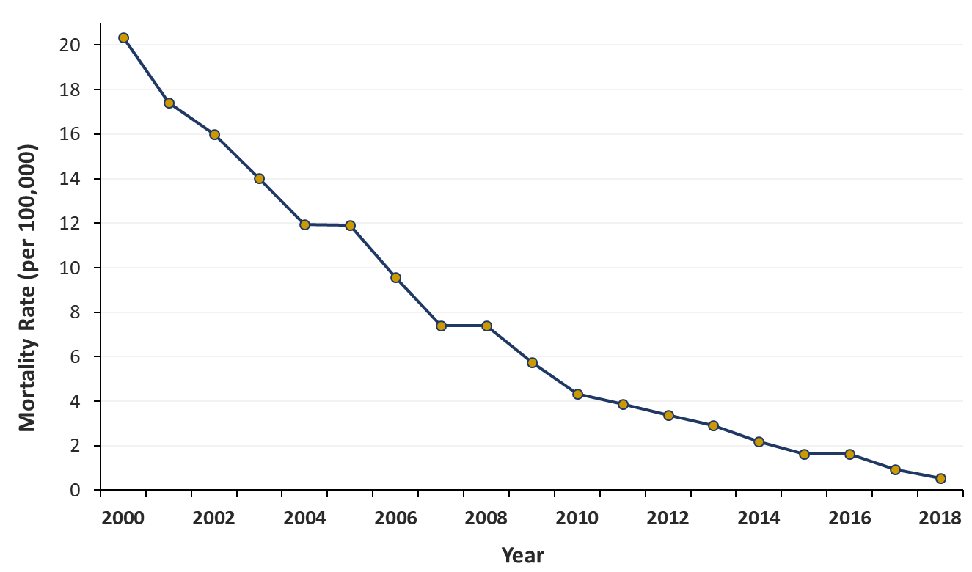
No evidence of incresed mortality of HIV/AIDS
HIV Case Fatality Rates by Year,
Puerto Rico, 2000-18
HIV/AIDS Mortality Rate by Year,
Puerto Rico, 2000-18

Slide 17

The effect of Irma and Maria hurricanes in people living with HIV: people in Hospices had a different experience
AIDS patients
  Increased their care needs
  Limitation of Resources
  Poor hygienic conditions
  Increased probability of deteriorating their health
  Higher chance of death
Courtesy of Mrs. Ivette González

Slide 18
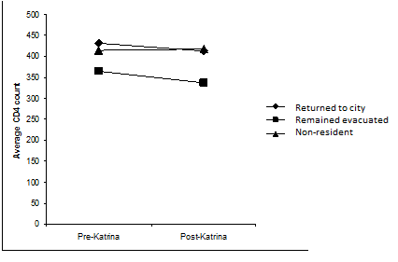
Average CD4 Counts Pre and Post Katrina for Evacuees, Returnees and Other state residents
Impact of Hurricane Katrina on the Louisiana
HIV/AIDS Epidemic: A Socio-Ecological Perspective
William T. Robinson
http://dx.doi.org/10.5772/55472
In all Katrina is estimated to have cost over 100 billion dollars in damage and recovery costs with nearly 2000 people dead or presumed dead. While Katrina had impacts across the Gulf South, the city and metropolitan area of New Orleans Louisiana sustained the most devastation, which resulted in a near total evacuation of the city that continues to be felt seven years later.

Slide 19
How many days it took to restore 95% of the peak number of customers left without power after major hurricanes since 2004, including Sandy, Ivan, Katrina, Rita, Wilma, Ike and Irene? http://www.pennlive.com/midstate/index.ssf/2012/11/restoring_power_to_hurricane_s.html
After Sandy, New York utilities restored power to at least 95% of customers 13 days after the peak number of outages was reported. New Jersey reached that same level in 11 days and West Virginia in 10 days.
The longest stretch to 95% restoration since 2004 was Louisiana after Hurricane Katrina, where local utilities had power restored to only three-quarters of their customers after 23 days before Hurricane Rita hit and caused additional outages.
Rita left Texas customers in the dark for 16 days; Katrina knocked out power to Mississippi customers for 15 days; Wilma and Ike knocked Florida and Texas out for 14 days each before power was restored to 95% of those who lost it, according to the federal data.

Slide 20
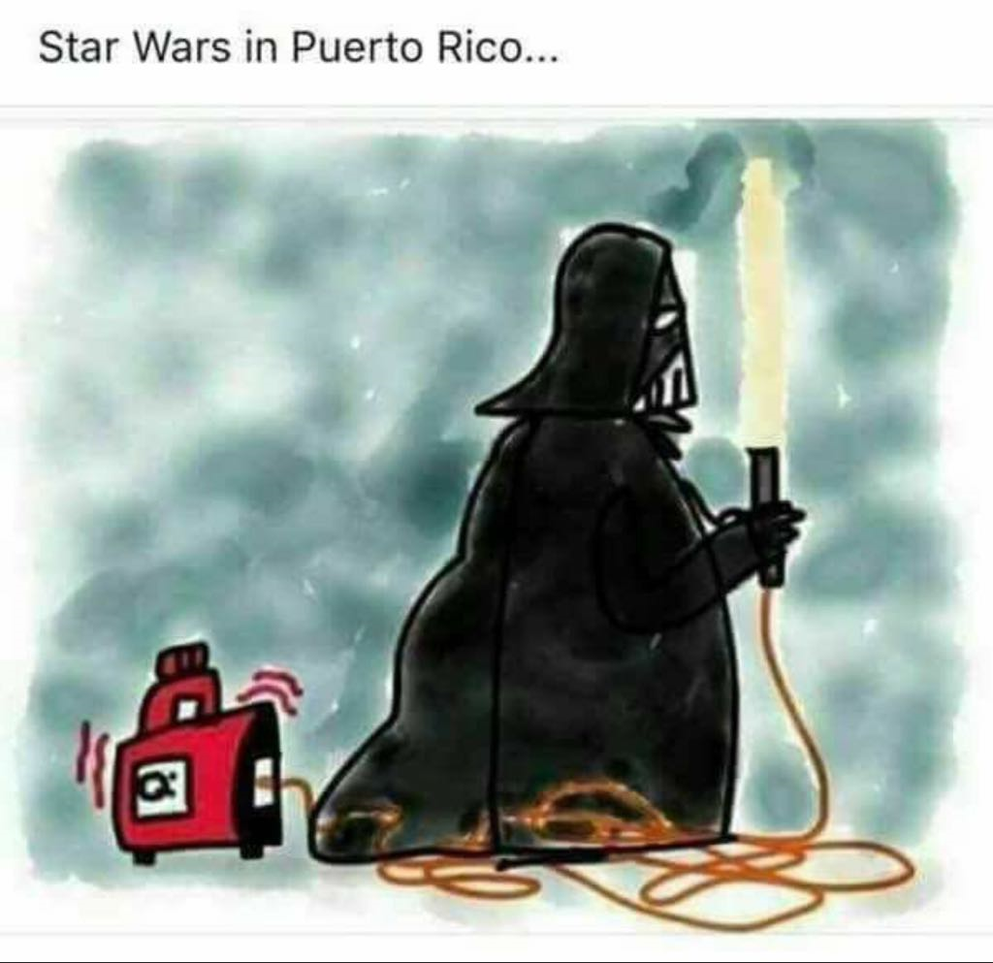




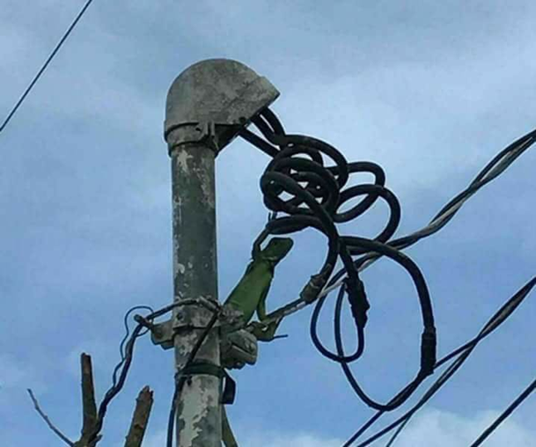
Humor in social media

Slide 21




Powerful Photos of Ballet Dancers in Puerto Rico 5 Months After Hurricane Maria
By Jessica Stewart on March 20, 2018

